Slide 1
Monthly Finance Performance Report
For the period ended 31st March 2022 (Month 12)
Presented by | Jonathan Wilson; Chief Financial Officer
Prepared by | Justin Betts; Deputy Chief Finance Officer Amit Patel; Head of Financial Management Lubna Dharssi, Head of Financial Control Richard Allen; Head of Income and Contracts

Slide 2
Key Messages
Monthly Finance Performance Report
For the period ended 31st March (Month 12)
Statement of Comprehensive Income
Statement of Financial Position
Financial Position £3.08m surplus in month including support | For March the Trust is reporting:- £17.77m deficit year to date pre COVID support and top-up funding; £37.55m of COVD support and top-up funding, resulting in a; £19.77m surplus year to date.
Income £23.01m in month | Total trust income was £23.01m in March, a £0.42m adverse variance to plan, largely linked to activity delivery. Material variances include:- Commissioned Clinical Income £0.66m adverse (£21.18m YTD); Other Clinical Income £0.17m adverse (£0.66m YTD); Commercial Income £0.16m favourable (£0.35m YTD); COVID top up payments included a further £1.0m distribution received from the NCL system reserve notified on 25th March. Activity levels recorded in March compared to 2019/20 activity levels were 69% of A&E activity, 88% Elective, 81% for Outpatients (excluding additive capacity or 91% inclusive), and 105% of Injection activity. Excess funding over activity levels contributed £0.13m in month and £16.72m year to date to the Trusts surplus reported position.
Expenditure £21.37m in month (pay, non pay, excl financing) | Pay is reporting expenditure of £12.43m in March, £0.26m adverse to plan. The key points to note are:- Temporary staffing levels increased in March across clinical staff groups in primarily cover covid sickness and annual leave. Bank and agency costs were £2.06m against the cumulative trend of £1.38m. a £1.035m accrual for unpaid 2021/22 and prior year CEA awards. annual leave provision releases of £1.3m, reducing expenditure Non-pay costs were £1.53m favourable to plan in March, with drugs cost reduction due to lower than planned hight cost (voretigene) drugs treatments. Other non pay favourable movements include a multi-year one off property rates rebate (£1.1m) and a backdated credit note from St Georges related to non-utilisation of QMR theatres (£0.21m) during the pandemic.
Cash and Working Capital Position | The cash balance as at the 31st March was £69.3m, an increase of £0.9m since the end of March 2021. The Better Payment Practice Code (BPPC) performance in March was 96% (volume) and 96% (value) against a target of 95% across both metrics.
Capital (both gross capital expenditure and CDEL) | Capital expenditure to 31st March totalled £14.8m, against a plan of £18.1m predominantly linked to network strategy decision timelines surrounding consolidation which meant schemes were not be able to be executed in this financial year and have been incorporate into 2022/23 TIF funding schemes, and slippage within schemes such as London Claremont Centre.
Use of Resources | Current use of resources monitoring remains suspended.

Slide 3
Trust Financial Performance - Financial Dashboard Summary

Slide 4
Trust Income and Expenditure Performance
Commentary
Operating Income £0.42m adverse to plan pre support | On a like for like comparison, clinical activity levels recorded were 88% for Daycase and 81% for Outpatients during March compared to 2019/20 levels, with activity-based income totalling £14.55m, £0.66m below the level of block funding. Other significant variances included:- Commercial Trading income was £3.44m; £0.16m favourable to plan. Research and Development income was £2.34m; a break-even position Other income was £0.22m favourable to plan in month, reflecting additional HEE monies reported in month. COVID top up payments included a further £1.0m distribution received from the NCL system reserve notified on 25th March.
Employee Expenses £0.26m adverse to plan in month | Pay in March is reported as £12.43m against a cumulative trend of £11.68m. Bank and agency costs totalled £2.06m in March; an increase on the £1.28m reported in March 2020. Although the Trust has experienced a reduction in activity levels, temporary staffing costs remained high due to sickness and annual leave taken in March. Operational restrictions in clinical areas and temporary staffing expenditure in corporate areas (mainly linked to the IMT remediation plans) have caused costs to remain high. Clinical divisions (including Hercules) temporary staffing costs are £1.10m against £0.76m in March 2020. Further notable items to highlight include, a £1.035m accrual for unpaid 2021/22 and prior year CEA awards, offset by the annual leave provision reduction totalling £1.3m.
Non Pay Expenses £1.53m favourable to plan in month (non pay and financing) | Non-Pay costs in March were £8.94m against a cumulative trend of £9.06m. Drugs expenditure was £0.22m favourable to plan reflecting no Voretegene treatments in month, and lower wholesale drug activity for LCC. Actual expenditure was £3.38m in month against prior month expenditure of £2.82m. Clinical supplies expenditure was £0.17m adverse in month reflecting increased expenditure in City Rd Theatres, in line with trend. Actual expenditure was £2.33m in March against £1.72m in February due to the recognition of DHSC Donated PPE stock for which income has also been received. Other non pay includes a multi-year one off property rates rebate (£1.1m) and a backdated credit note from St Georges related to non-utilisation of QMR theatres (£0.21m) during the pandemic.

Slide 5
Trust Patient Clinical Income Performance
Commentary
NHS Income | NHS Patient Clinical activity income in March was £14.55m if reimbursed via normal activity based contracting arrangements. Significant items include:- Inpatient activity The trust achieved 88% of baseline activity levels in March (94% in February); Outpatient Activity The trust achieved 91% of baseline activity levels in March (92% in February); however approximately 10% is via additive diagnostic hub activity and a further 2% is A&E attend anywhere activity, meaning like for like outpatient activity outside of these items achieved is 81% of 2019/20 levels. High Cost Drugs Injections The Trust achieved 105% of baseline activity levels in March (98% in February);
Activity Plans | The charts to the left demonstrate the in year activity levels compared to the previous three years, highlighting the material shift in activity as a result of COVID, and the pace of recovery towards pre-COVID activity levels. 2019/20 activity levels (pre-COVID) are being used nationally as a proxy to report organisations return and recovery to pre pandemic levels of activity during 2021/22. The red line represents average 2019/20 activity levels pre additive capacity. Where the upper and lower lines increase represent additive capacity such as Hoxton, Brent Cross, and other diagnostic hub investments.

Slide 6
Trust Statement of Financial Position – Cash, Capital, Receivables and Other Metrics
Commentary
Cash and Working Capital | The cash balance as at the 31st March was £69.3m, an increase of £0.9m since the end of March 2021, and a reduction £9.0m from the prior month.
Capital Expenditure | Capital spend to 31st March totalled £14.8m, against a plan of £18.1m predominantly linked to network strategy decision timelines surrounding consolidation which meant they were not be able to executed in this financial year and have been incorporate into 2022/23 TIF funding schemes and slippage within schemes such as London Claremont Centre.
Use of Resources | Use of resources monitoring and reporting has been suspended.
Receivables | Receivables have increased by £3.5m to £16.5m since the end of the 2020/21 financial year and an increase of £1.8m since last month. The increase is linked to the billing of R&D contracts following formal contract signatures including Hercules I, NIHR and other commercial projects.
Payables | Payables totalled £27.4m at the end of March, an increase £0.1m since March 2021. Creditor days are 92 at the end of March due to high levels of capital invoice and revenue accruals. These will be paid in the new year and the metric will therefore be closer to the target of 45 days. The trust’s performance against the Better Payment Practice Code (BPPC) was 96% (volume) and 96% (value) against a target of 95%. Prior month achievement was 97% and 97% across both areas.

Slide 7
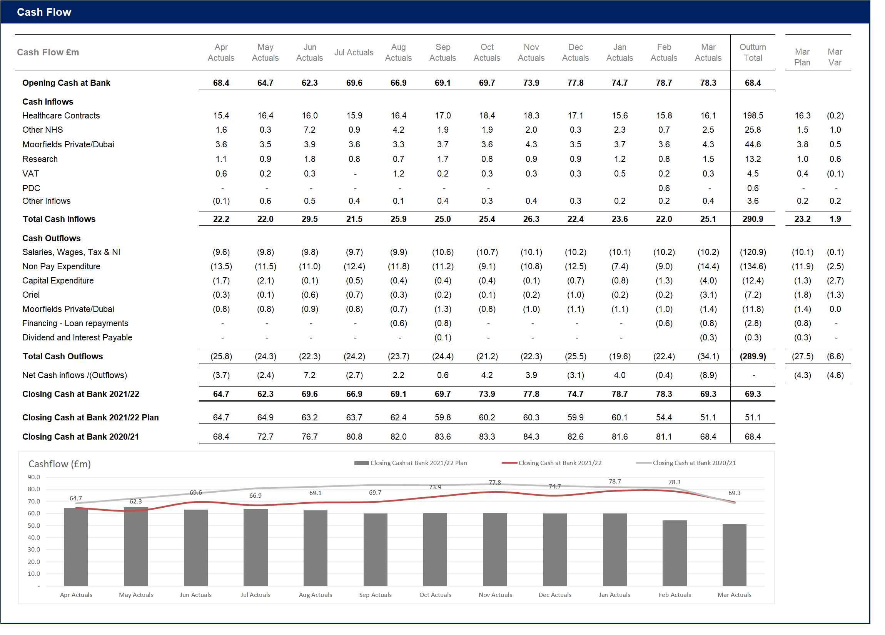
Trust Statement of Financial Position – Cashflow
Commentary
Cash flow | The cash balance at the 31st March is £69.3m, lower than forecast due to large payments of capital spend at the end of March . The current financial regime has resulted in block contract payments which gives some stability and certainty to the majority of cash receipts. The Trust currently has 104 days (prior month: 118 days) of operating cash. March saw a cash outflow of £8.9m against a plan of a £4.3m due to the timings of payments to suppliers in particular linked to capital and Oriel.

