Slide 1
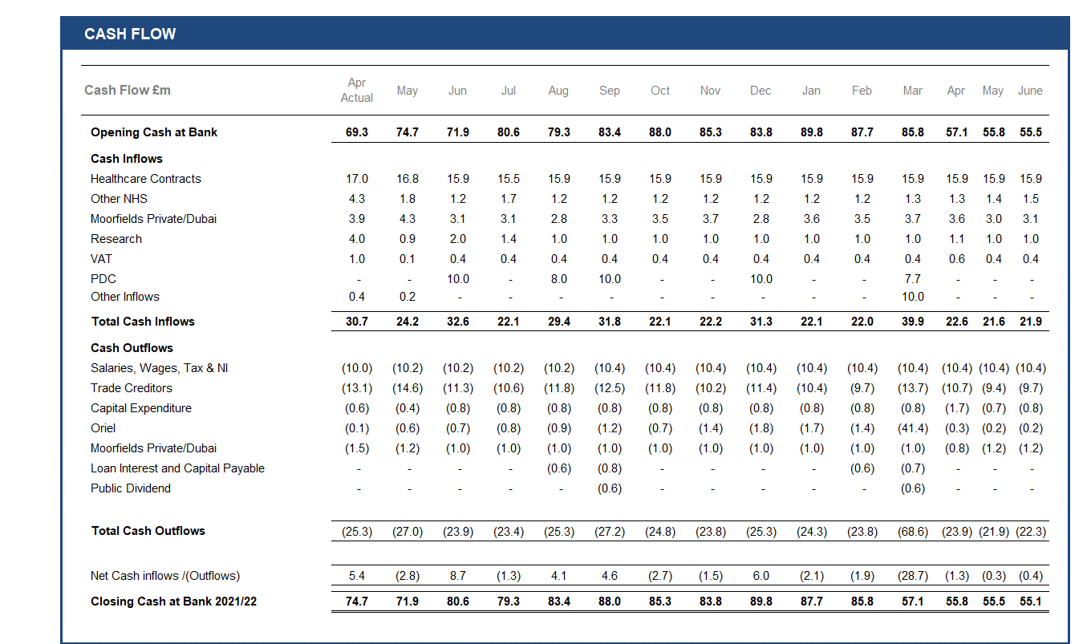
Trust Statement of Financial Position – Cashflow
Appendix C

